Slide 1
DX University
Visalia California – 2014

Slide 2
Internet Resources
for the DXer
Darryl Hazelgren, K7UT

Slide 3
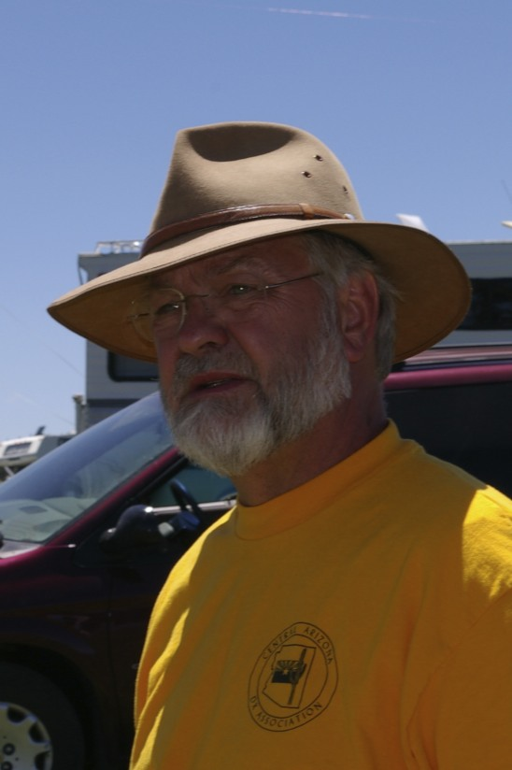
Darryl Hazelgren, K7UT
First licensed in 1959 as KN7KPQ. Has held the following calls: K7KPQ, DJ0KO, AF7O, WA7S, VK9WX. Trustee for UDXA club call: K7UM
ARRL DXCC Honor Roll. 8 Band DXCC. QRP DXCC. Challenge Award:1830 points
DXpeditions include VK9WM, 8Q7AA, XZ1N, XZ0A, 9M0M.
Contesting Sucesses: Sweepstakes Rocky Mtn Division wins 2005, 2006. 7QP Overall winner 2010.
2008 Rocky Mountain Division Ham of the Year

Slide 4
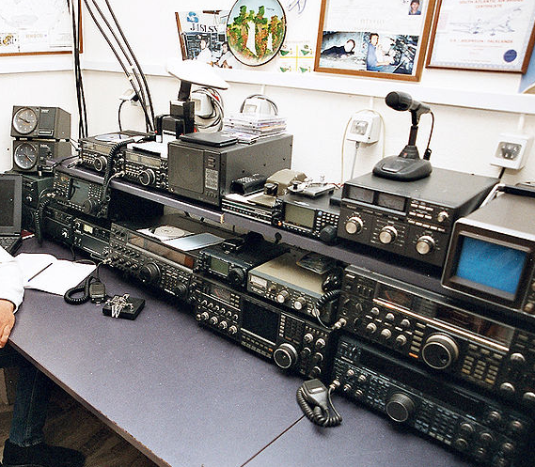
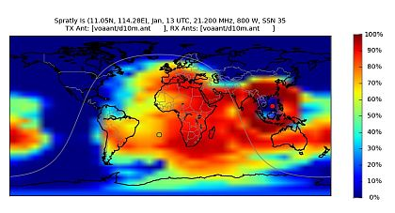
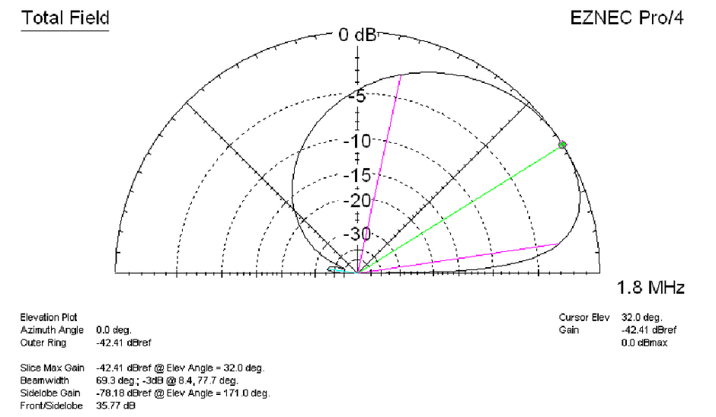
Station building
Propagation

Slide 5
Station building
Propagation
Internet Resources
for the Dxer

Slide 6
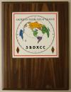

Slide 7
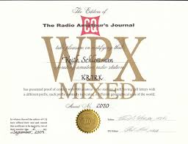
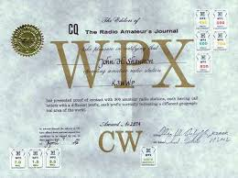
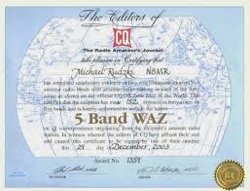

Slide 9
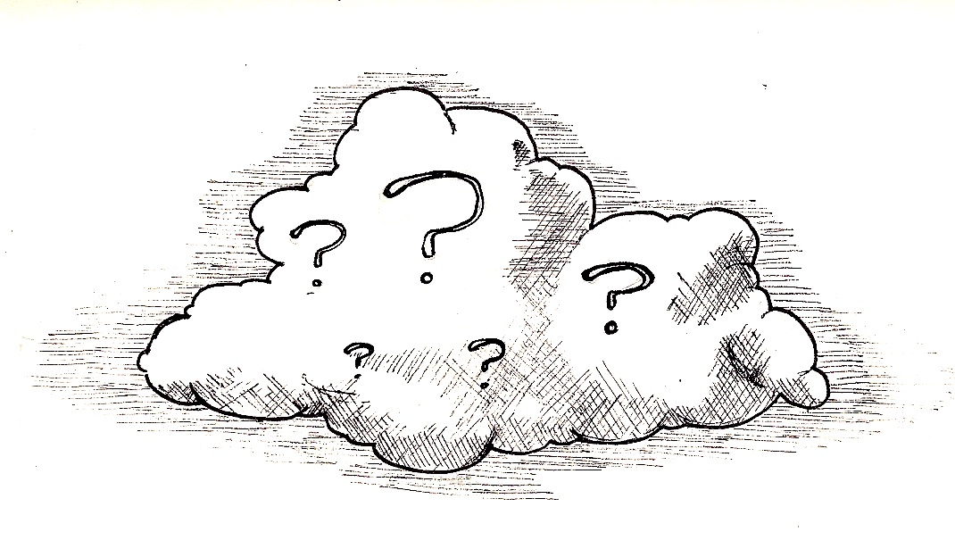
How do you get your information?

Slide 11
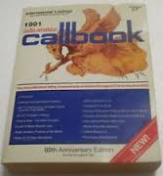
Information sources - then

Slide 12
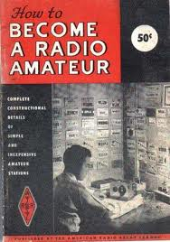
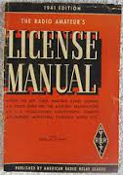
Information sources - then

Slide 13
How to find them – current times

Slide 14
What is available online today?
How to get licensed
Rules and regulations
Technical information
Who to work
When and where to find them
Operating aids
Awards and programs
QSLing info

Slide 15
In what format is information online today?
Websites
Articles, Magazines, eBooks
Videos (YouTube, etc.)
Reflectors/Mail lists
Webinars (PVRC)
Club websites

Slide 16
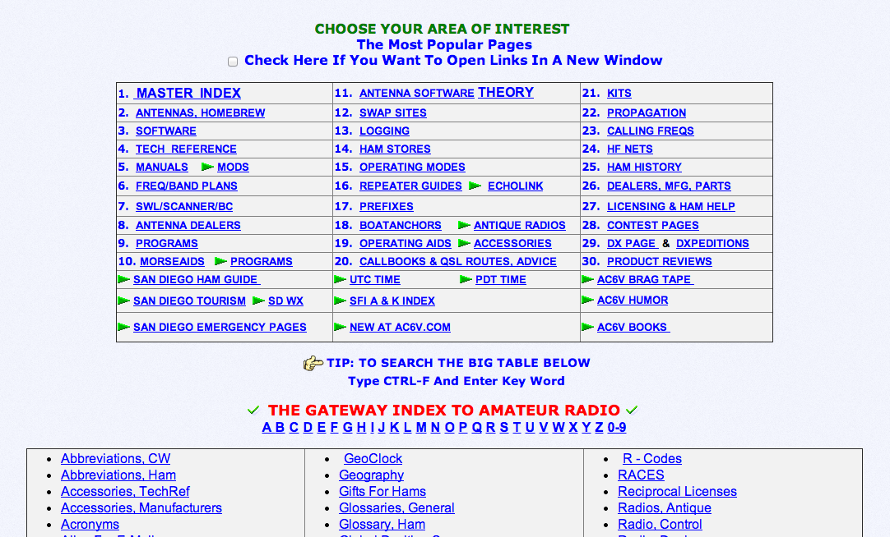
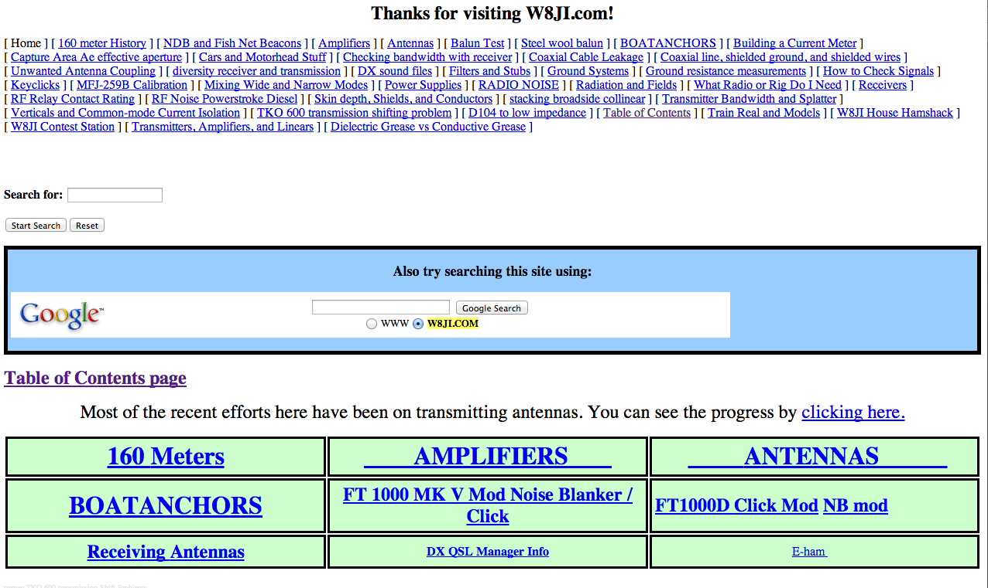
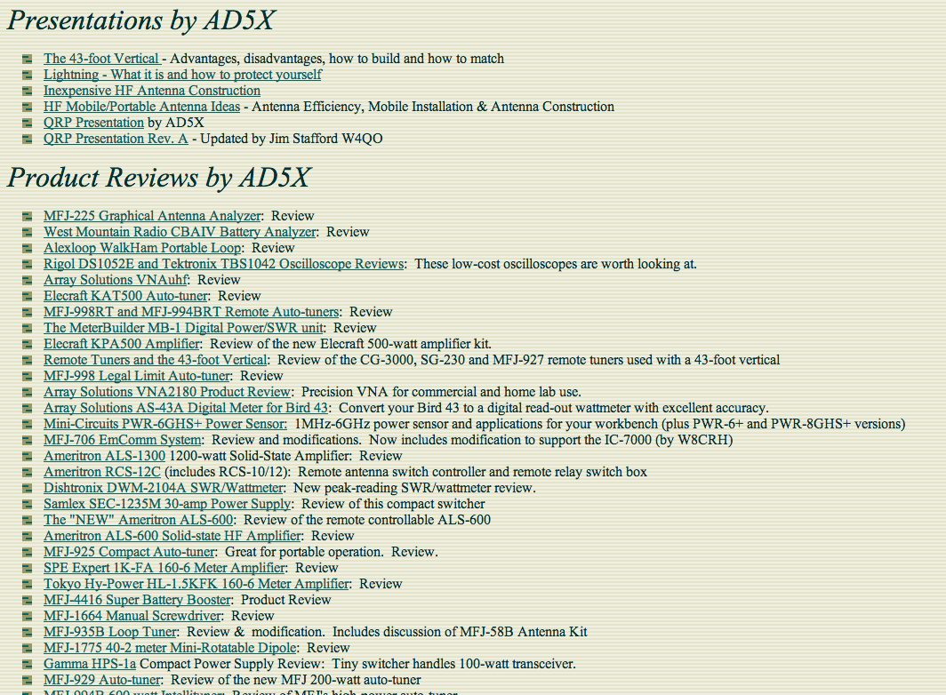
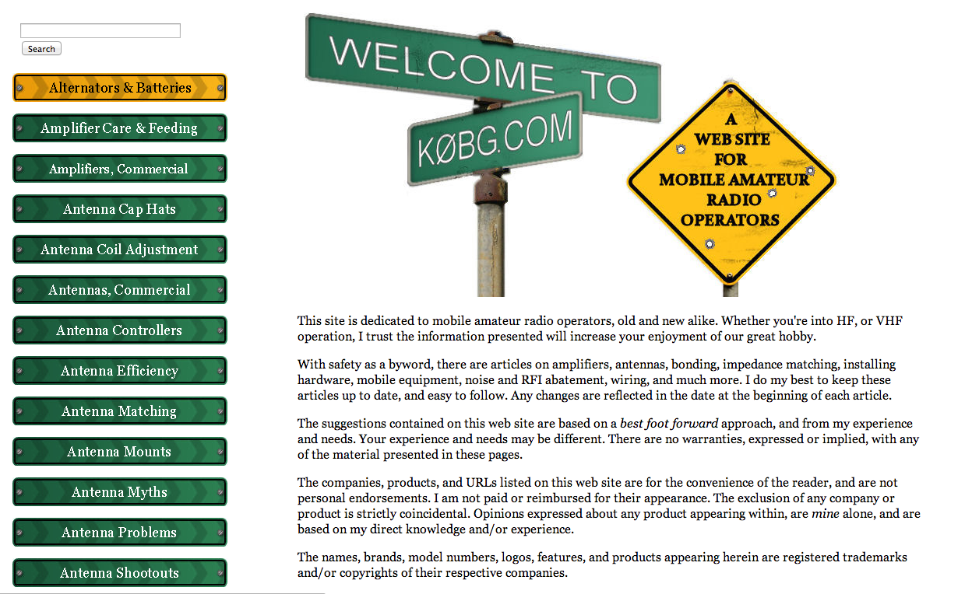
REFERENCE SITES
AC6V
W8JI
AD5K
K0BG

Slide 18
REFERENCE SITES

Slide 19
REFERENCE SITES
• w8iJ

Slide 20
REFERENCE SITES

Slide 21
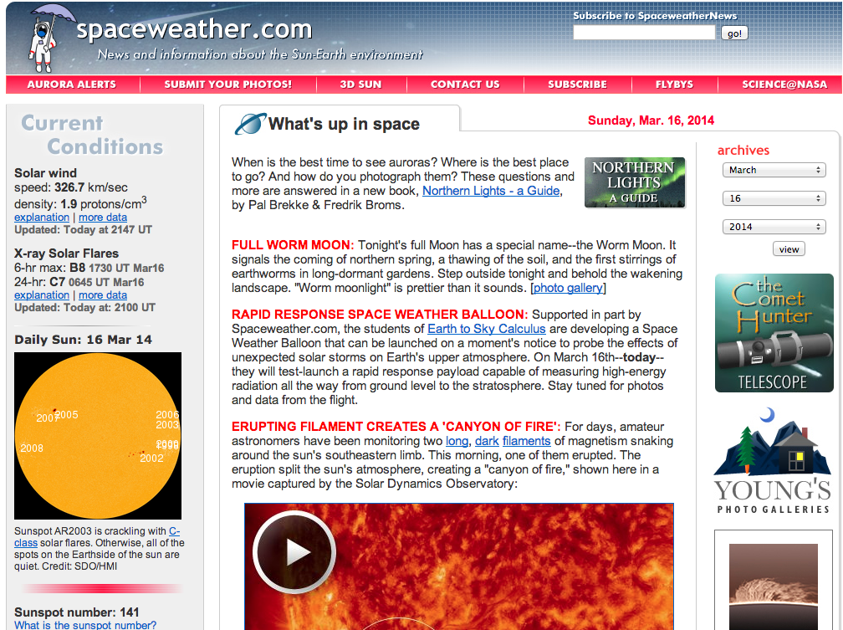
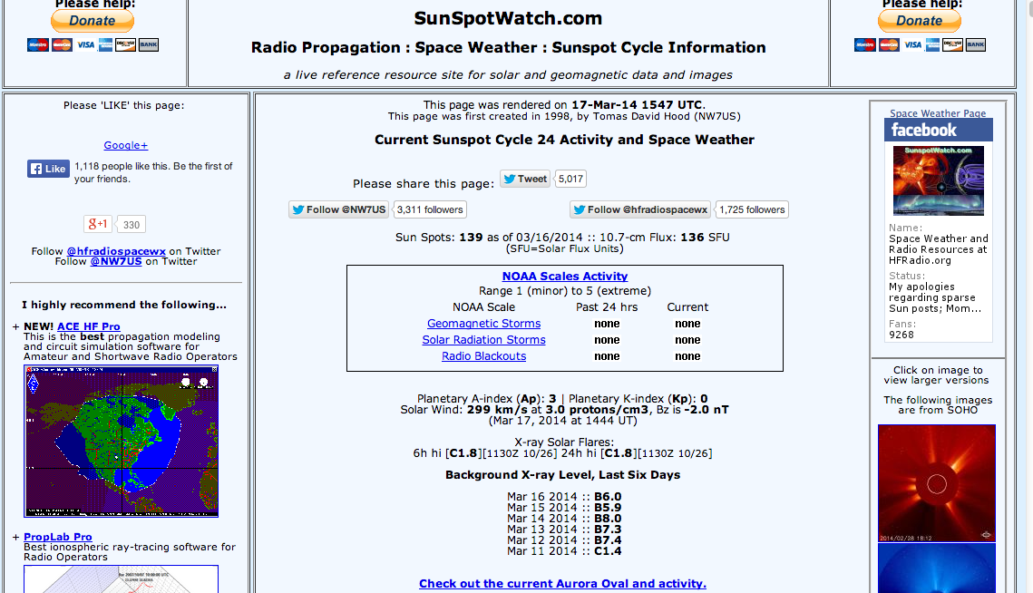
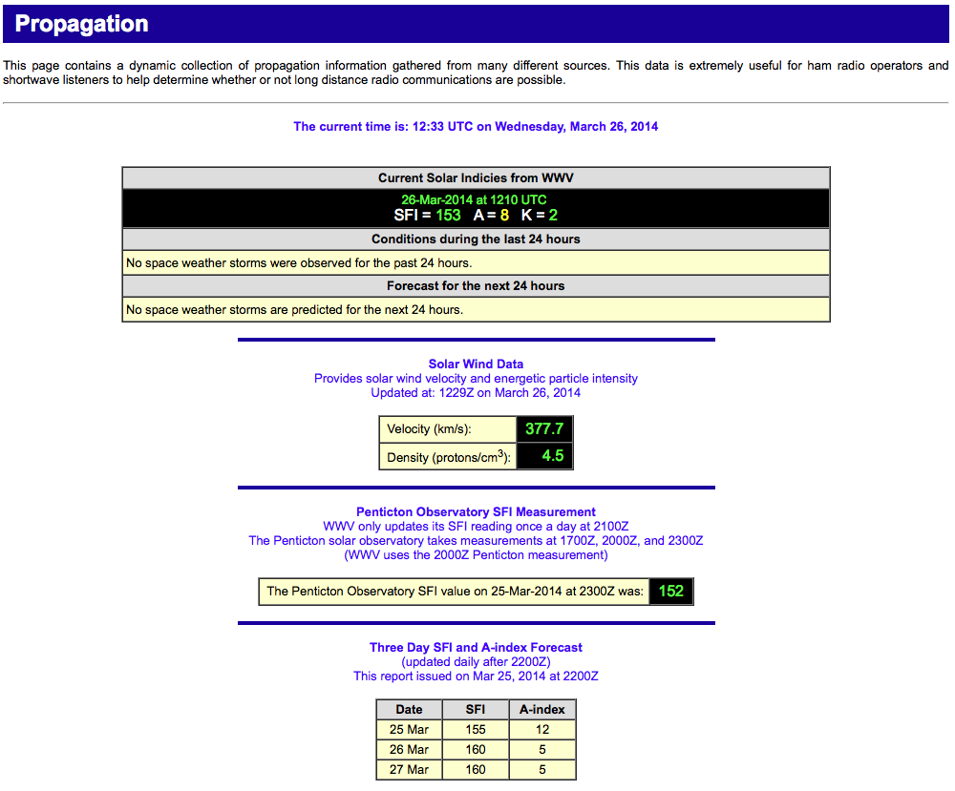
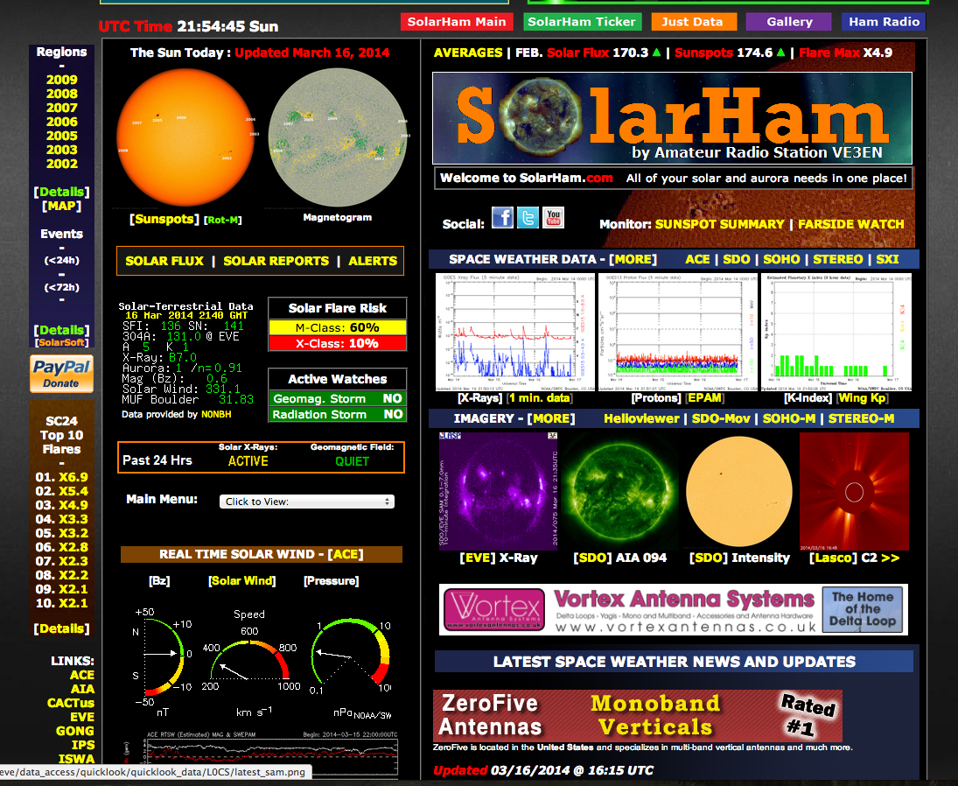
Propagation

Slide 22
http://dx.qsl.net/propagation

Slide 23
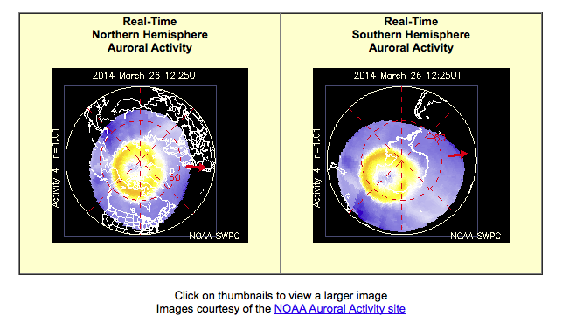
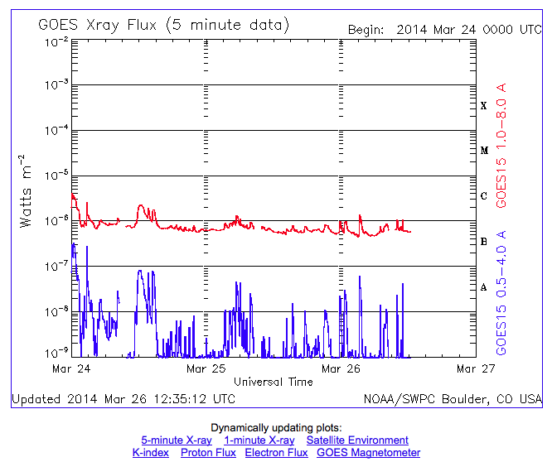

Slide 26
EL Prop?

Slide 28
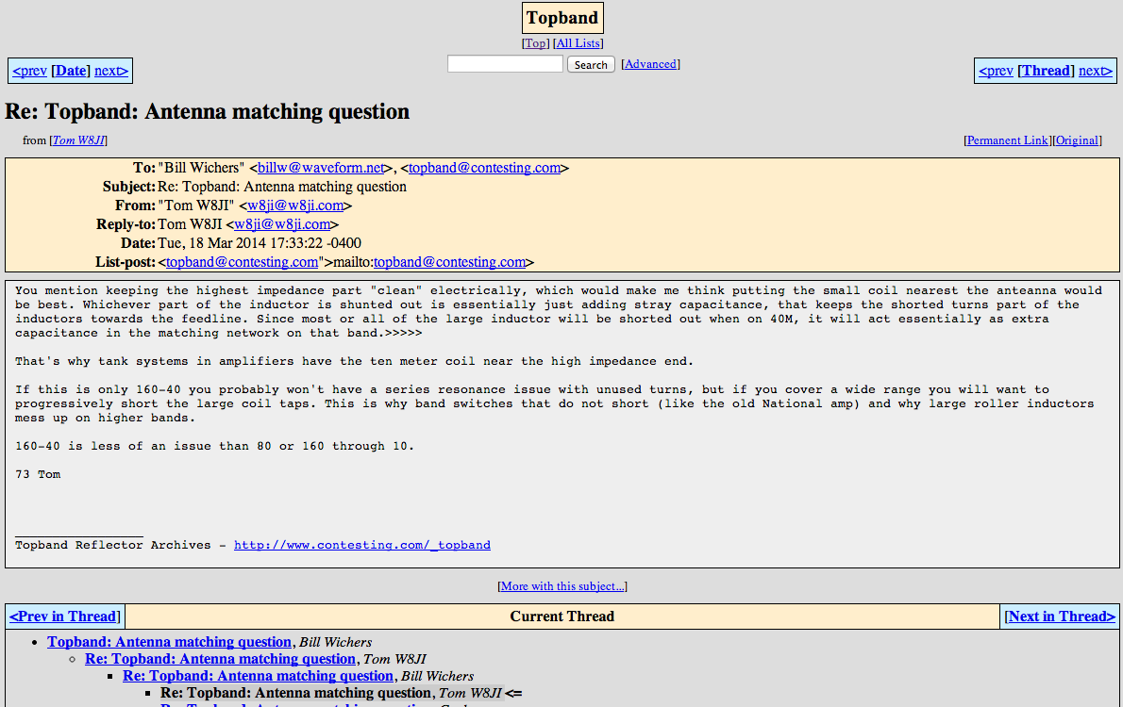
Reflectors/Mail Lists

Slide 29
Reflectors/Mail Lists
Contesting.com lists:
Topband
TowerTalk
3830
Amps
utilize the archives!

Slide 30
Club websites

Slide 31
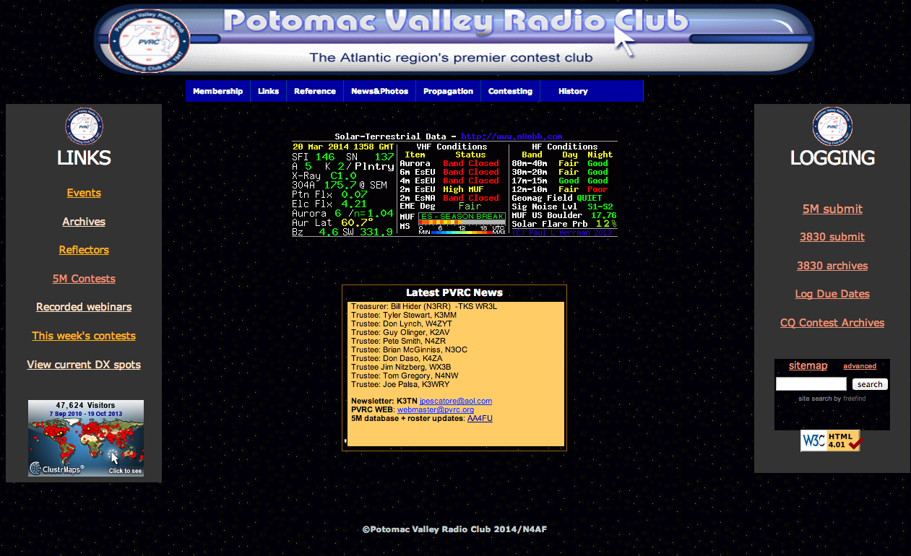
Webinars

Slide 32
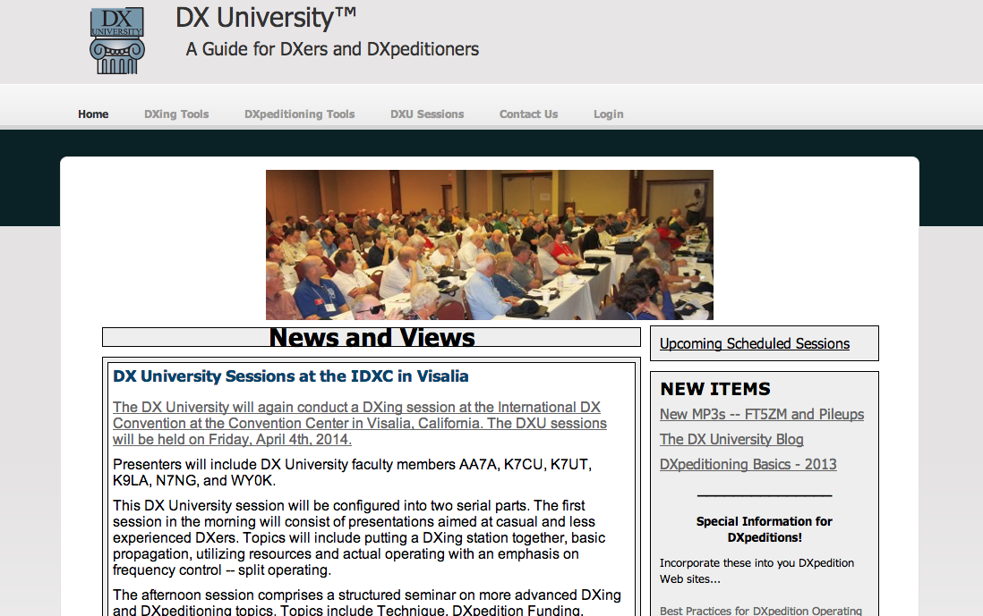

Slide 33
A DXer wants to know:

Slide 35
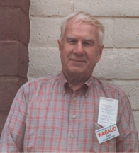
WA6AUD, Cass
Circulation of 3200, published for 11 years 1968-1979

Slide 36
How to find them – Now
Newsletters/Bulletins
Reflectors (mail lists)
Websites
Packet clusters
Search engines

Slide 37
Newsletters/Bulletins
ARRL DX Bulletin
OPDX Bulletin
425
DXNL

Slide 38
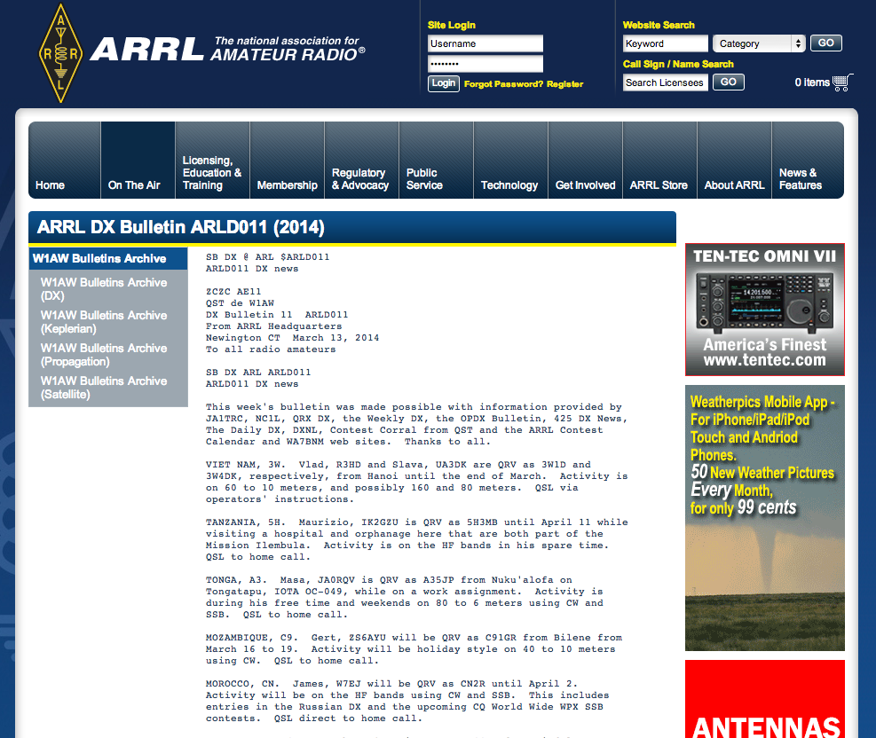
ARRL DX Bulletin

Slide 39
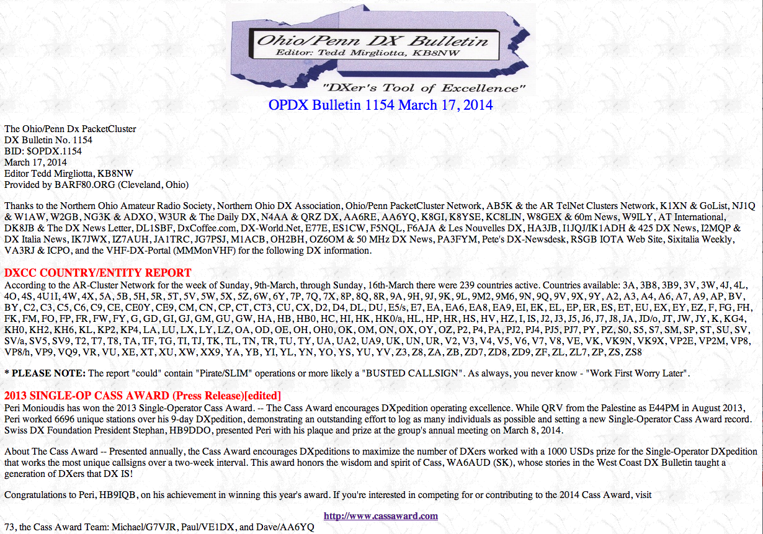

Slide 40
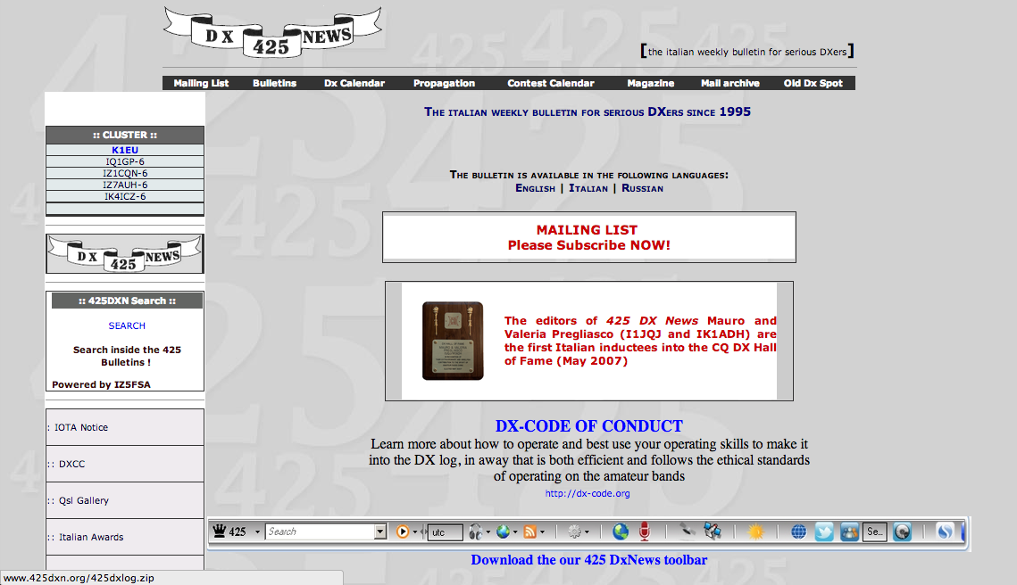

Slide 41
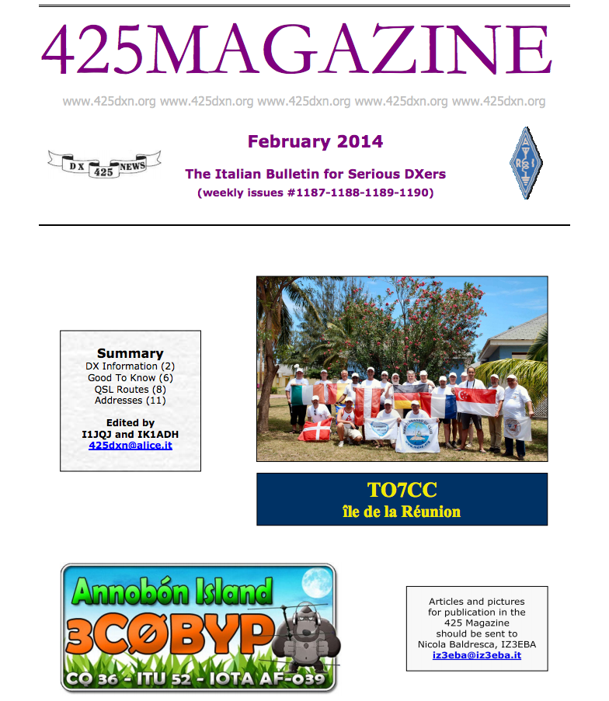
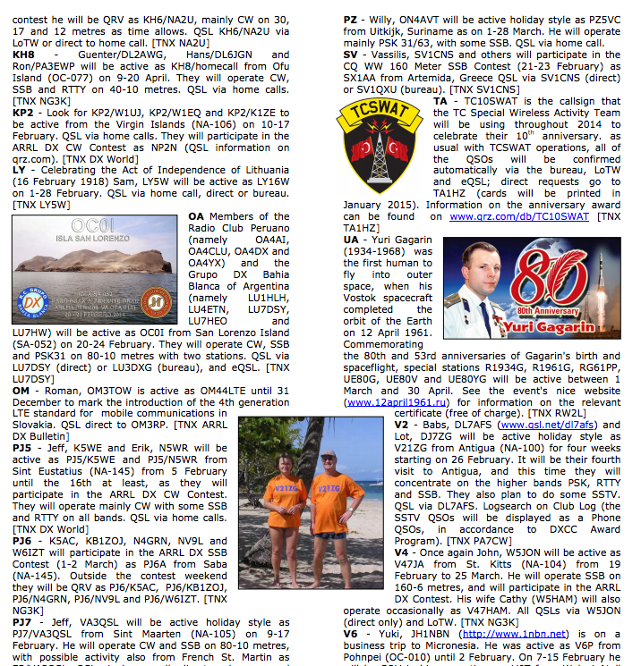

Slide 42
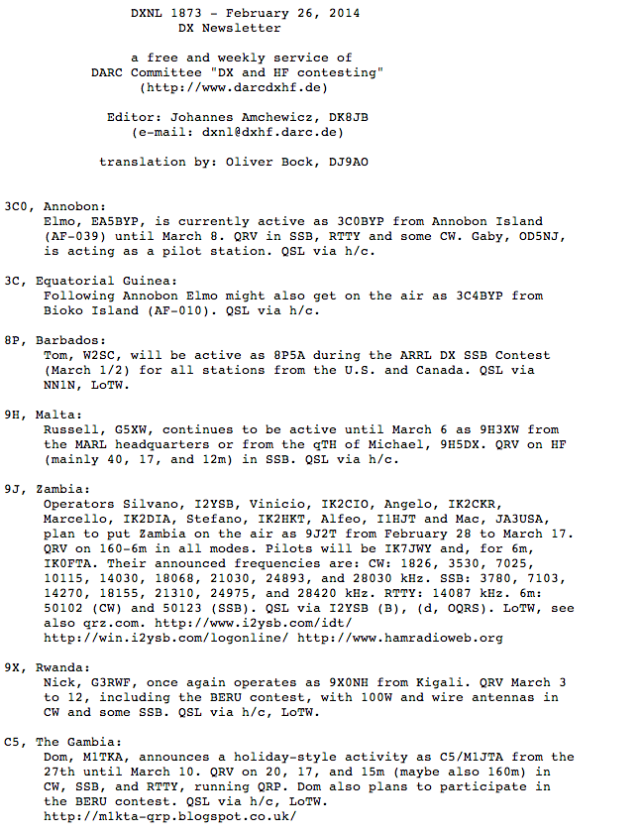

Slide 43
Newsletters/Bulletins
QRZ DX
The Daily DX
The Weekly DX

Slide 45
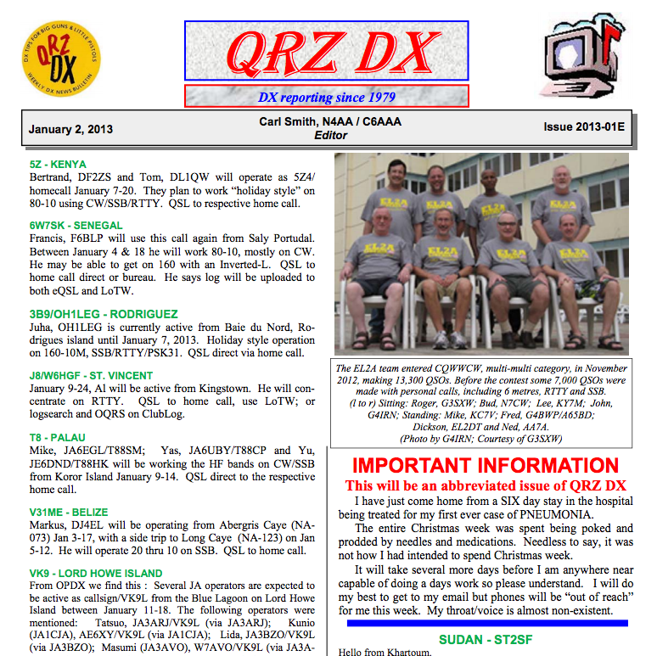

Slide 47
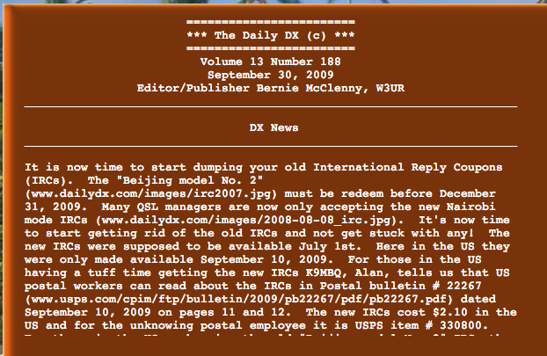

Slide 48
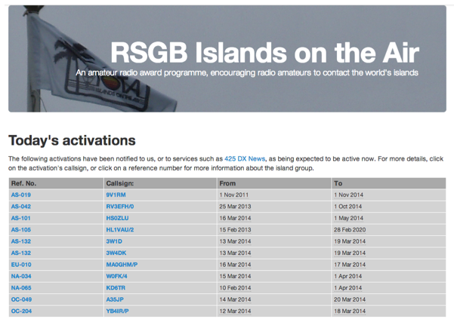
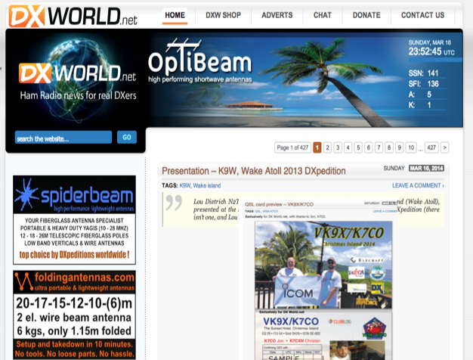
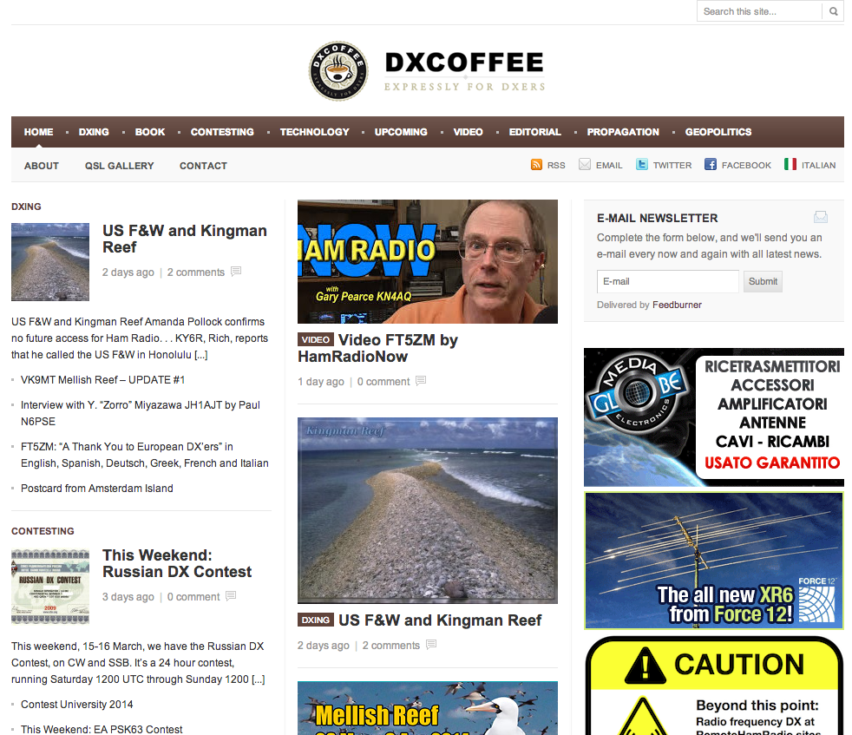
Websites

Slide 49
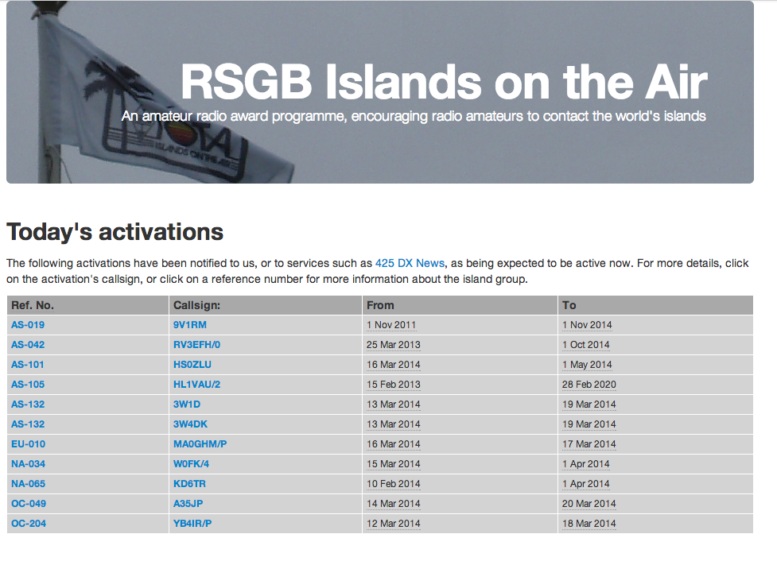
IOTA

Slide 51
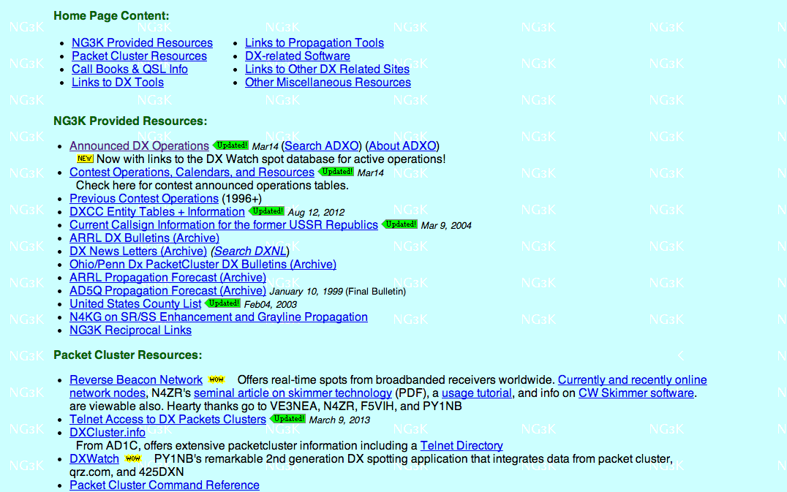
NG3K WEBSITE

Slide 53
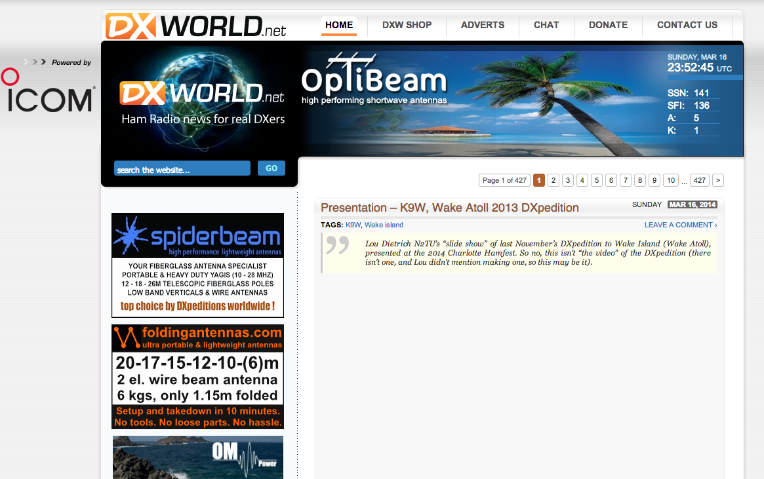
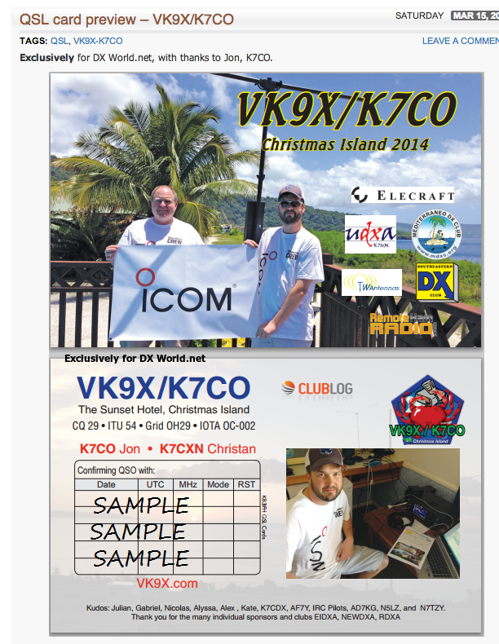
DX World

Slide 54
Websites

Slide 56
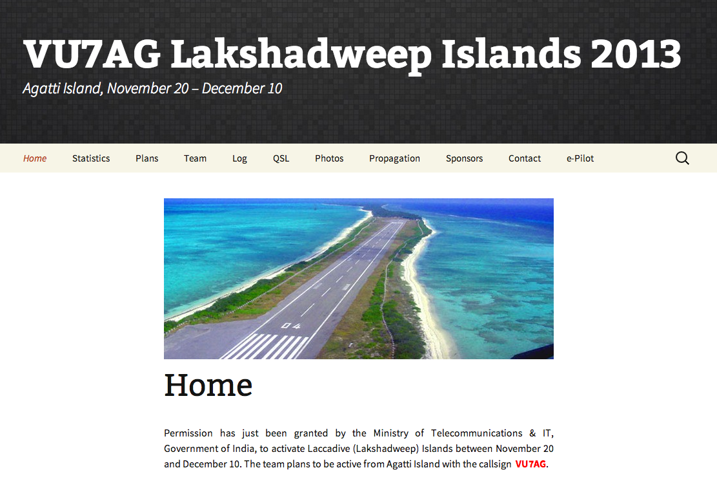
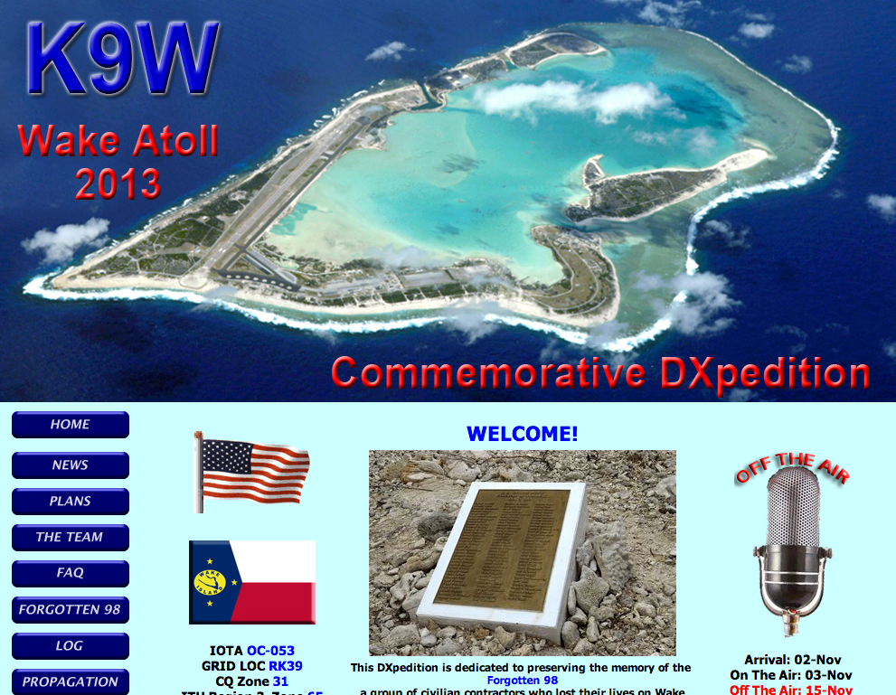
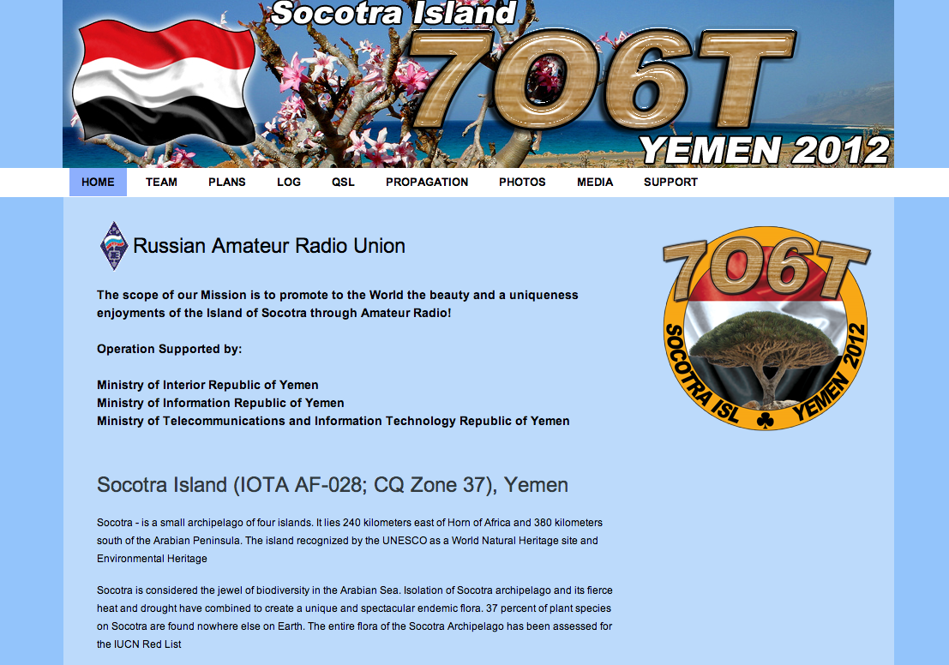
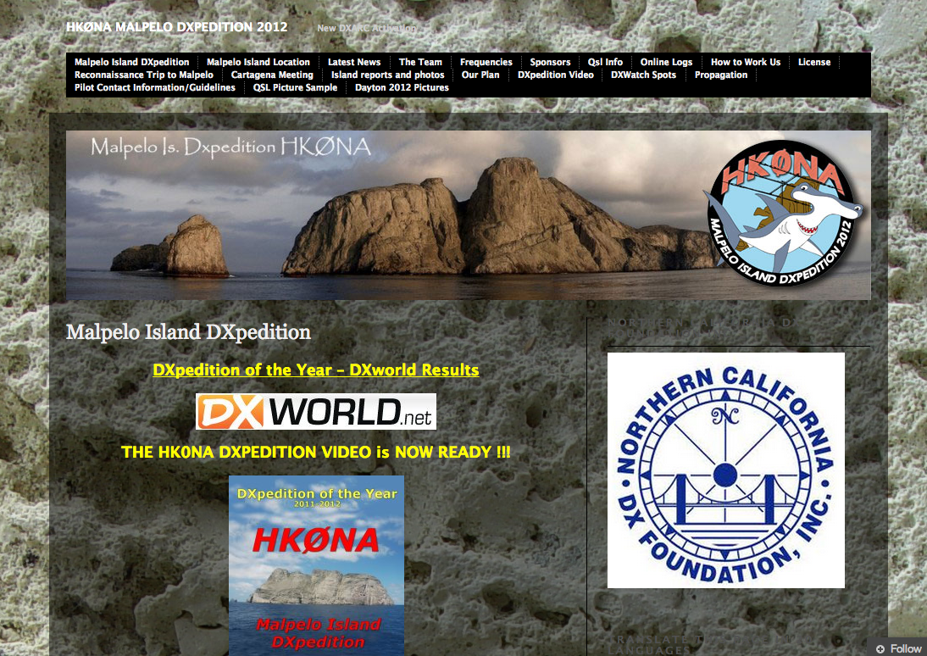
DXpedition Websites

Slide 57
Dxpedition Websites
DXpedition Websites include:
– Bio’s, equipment, antennas
– Propagation
– Suggested frequencies
– Log search, QSL info, OQRS
– Photos and much more

Slide 58
Dxpedition Websites

Slide 60
Use Google and other search engines to find old, current and upcoming DXpedition news and QSL information.

Slide 62
Now I know who I want to work, but who can I work right now?

Slide 64
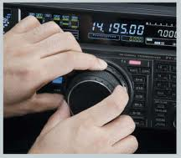
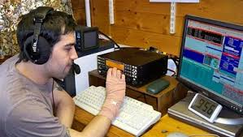
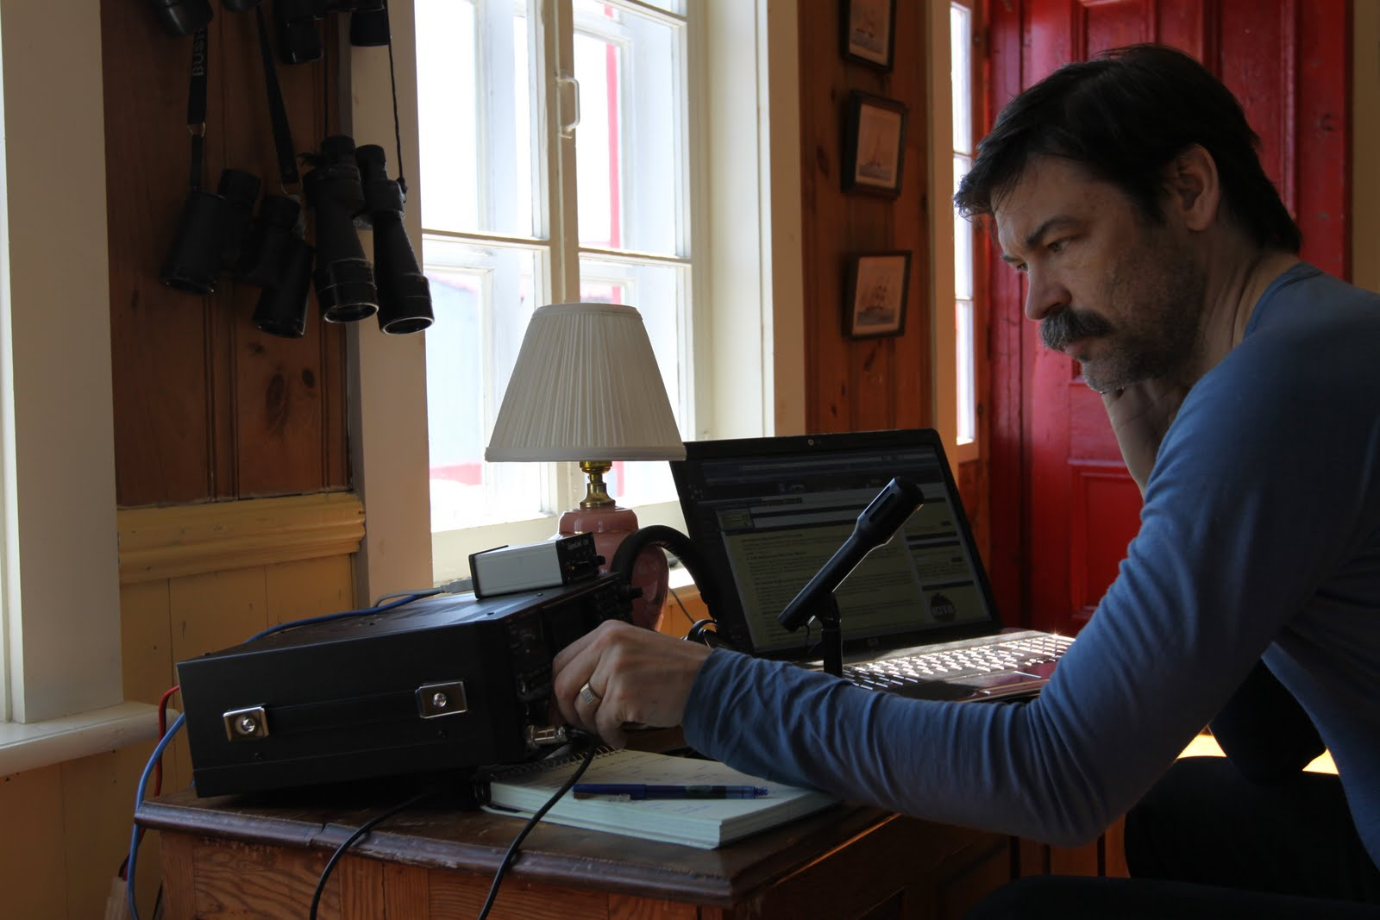
Tune the bands…

Slide 65
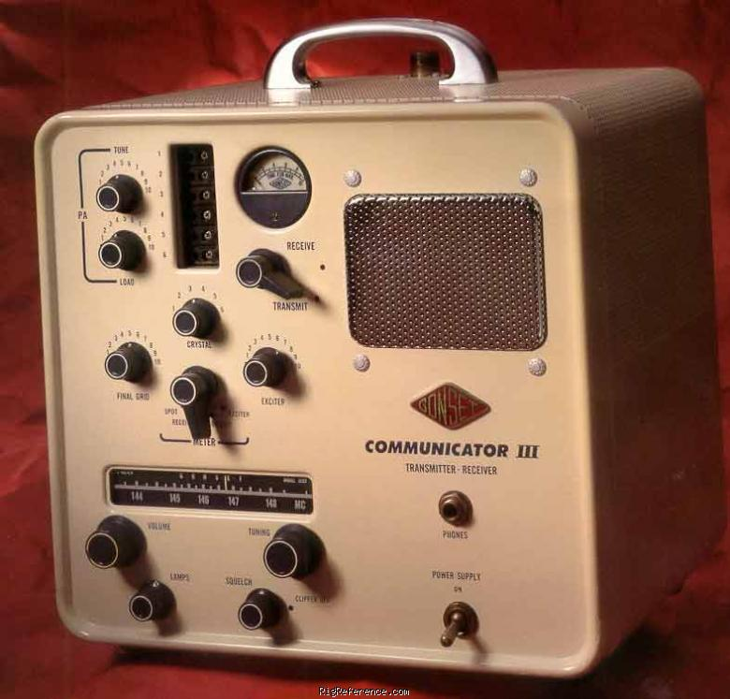
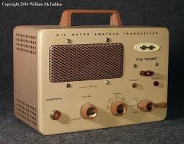
How to find them – then
* 2 meter spotting networks

Slide 66
How to find them – then
* One ringers

Slide 67
Packet Clusters
DX Cluster Network
– DX Summit
– Telnet
– Dxwatch.com
– VE7CC
– Reverse Beacon Network

Slide 70
DX Summit

Slide 74
QSLing
QSL Information
– QRZ.COM
– IK3QAR (www.ik3qar.it)
– QSL INFO (qslinfo.de)
– OZ7C (www.ddxg.dk/oz7c/)
– K1XN (hamcall.net/call/K1XN)

Slide 80
Log Searches
Log Search
– Many DXpeditions have their own log search
– ClubLog
– Logbook of the World

Slide 82
Log Searches

Slide 89
Log Searches

Slide 91
Internet Resources
Other Information Sources
– Great Circle Maps & Bearings
– Google Earth
– Google Maps with LOCator
– Prefix Lists
– Country Profiles

Slide 92
Internet Resources
for the DXer
Darryl Hazelgren, K7UT

